Slide 1
Why was Galileo condemned?
Day 4

Slide 2
Review of the Data
Scientific Predictions of Copernicanism
Theological Principles of Interpretation

Slide 3
Vote: What got Galileo condemned?
Science
Theology

Slide 4
Extra Credit Opportunity
History, politics, and personality also played a role.
Watch the video and describe the function of these three factors.

Slide 5
Evidence for Copernicanism
Coriolis
Parallax
Tides

Slide 6
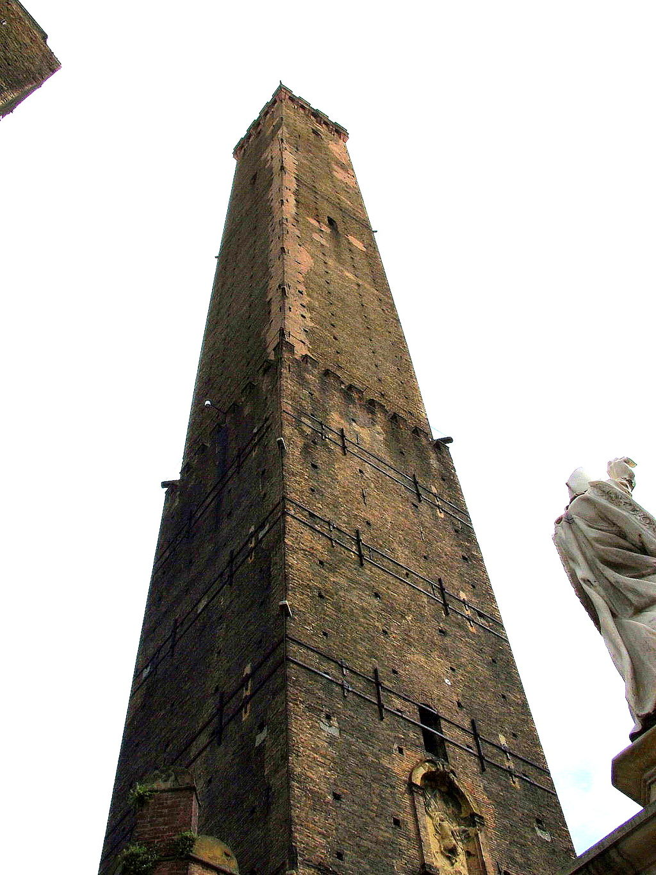
Coriolis
Shown by Guglielmini in 1789
Reich in 1832

Slide 7
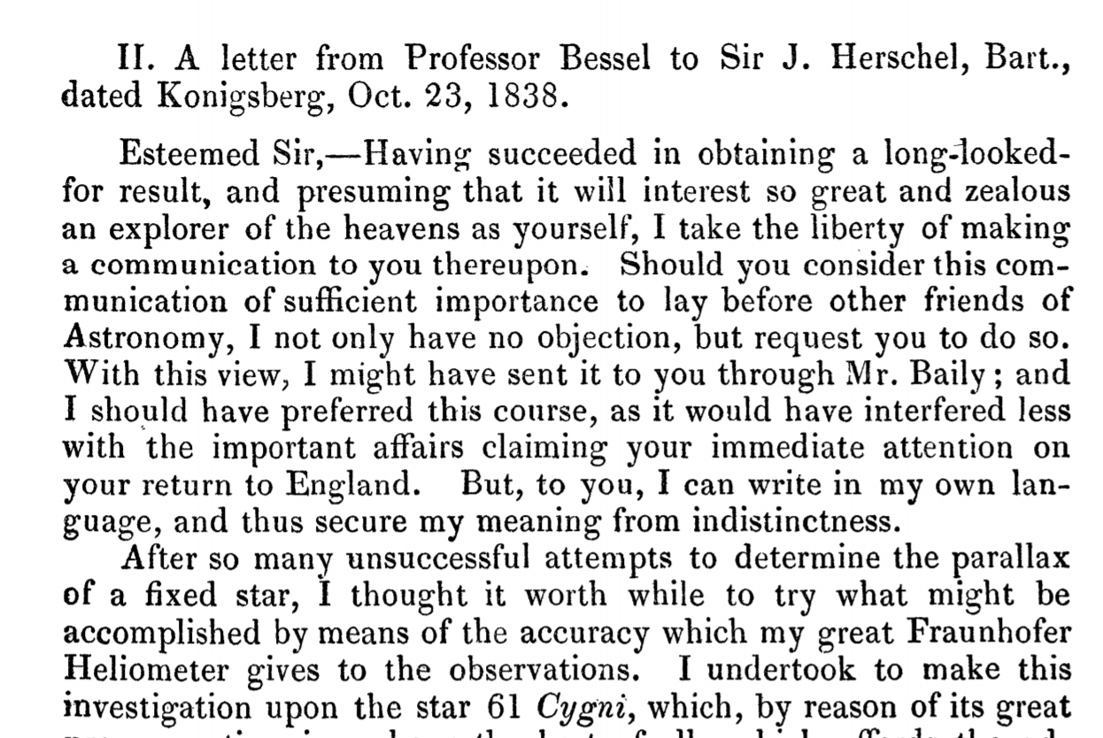
Parallax
Bessel - 1838
By IndividusObservantis - Own work, CC BY-SA 3.0, https://commons.wikimedia.org/w/index.php?curid=29672788

Slide 8
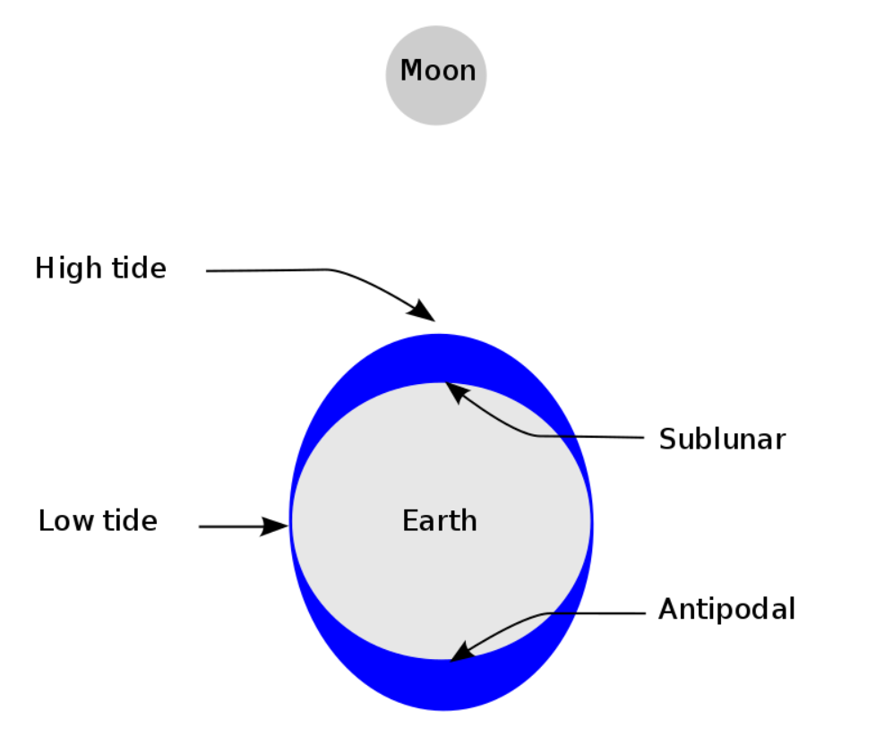
Tides
Caused by the moon and sun
There are 2 a day in most places
Needed a theoretical understanding of gravitation (Galileo’s “occult forces”) given by Newton (1687)and Einstein (1915)

Slide 9
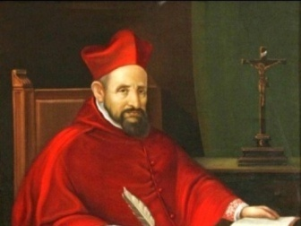
Bellarmine’s Final Say
Played important role in Galileo’s first encounter with ecclesiastical authorities
Letter to Foscarini - basically to Galileo
Read the bolded portions of his letter
Notes:
3 concepts to address
Biblical interpretation - Bellarmine’s “benefit of the doubt” to scripture not supported by later theologians without nuance
Scientific certainty - Bellarmine does not think it’s possible to reach certitude in sciences like astronomy
Proof - IF proof given, we’d have to readdress

Slide 10
Vote Part 2: What got Galileo condemned?
Science
Theology

Slide 11
Lesson Assessment: Reflection Paper
Reflect on what you’ve learned about the Galileo affair, and answer these questions using a combination of evidence from class and your personal experience.
What role did the scientific method play?
Why did the Church care?
How can this episode exemplify the need for humility and hope in both theological and scientific advances toward the truth?

